Slide 1


Grow Together, Thrive Together
Team 2: Johnny Chen, Ishneet Kaur, Heman Kolla

Slide 2
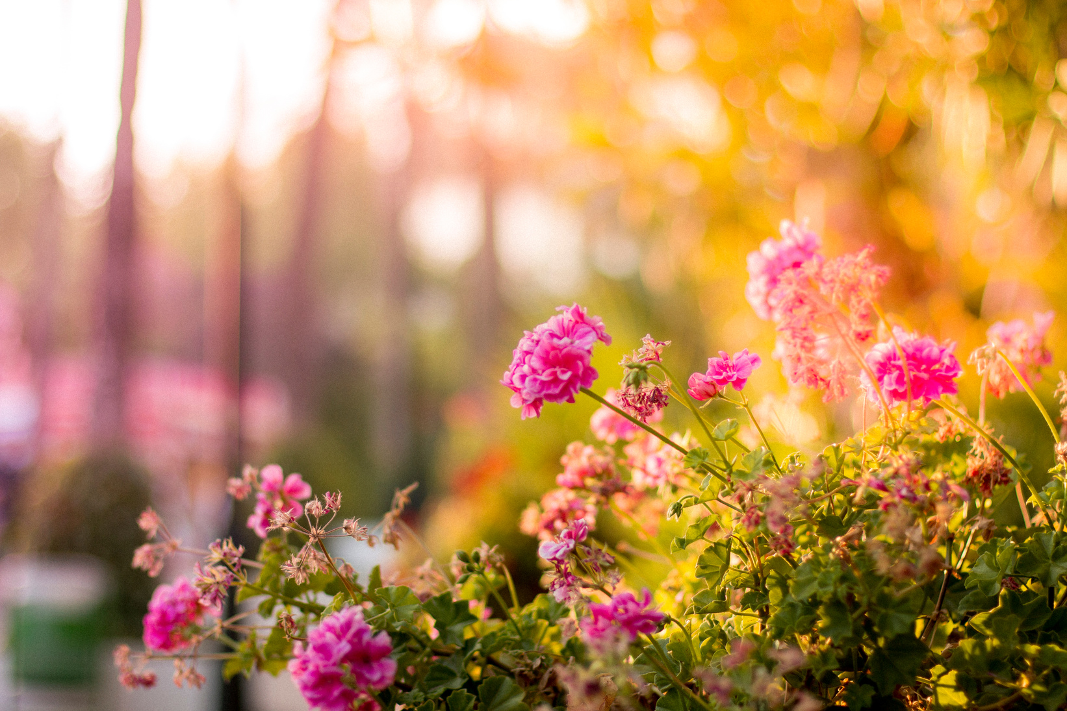
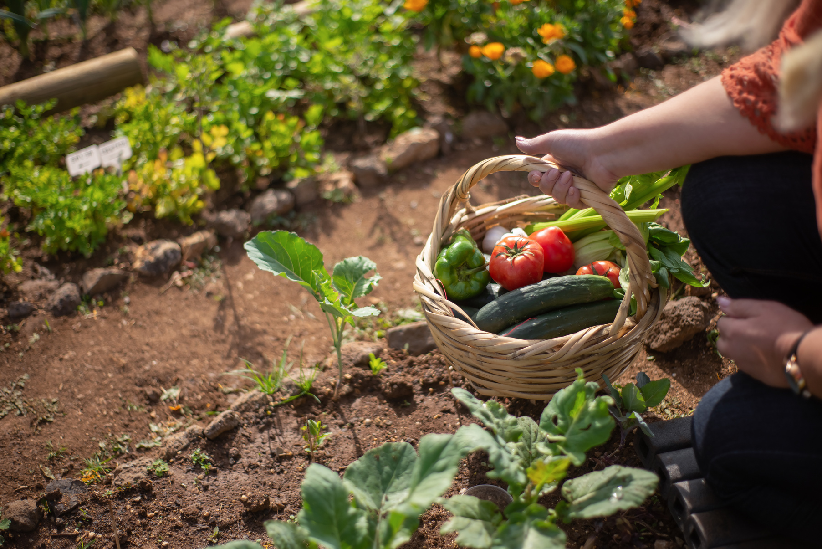
Our Application
Dirt & Deeds is a site directed toward community gardens that allows users to foster a community around their gardens by connecting them with volunteers, food banks, and other collaborators

Slide 3
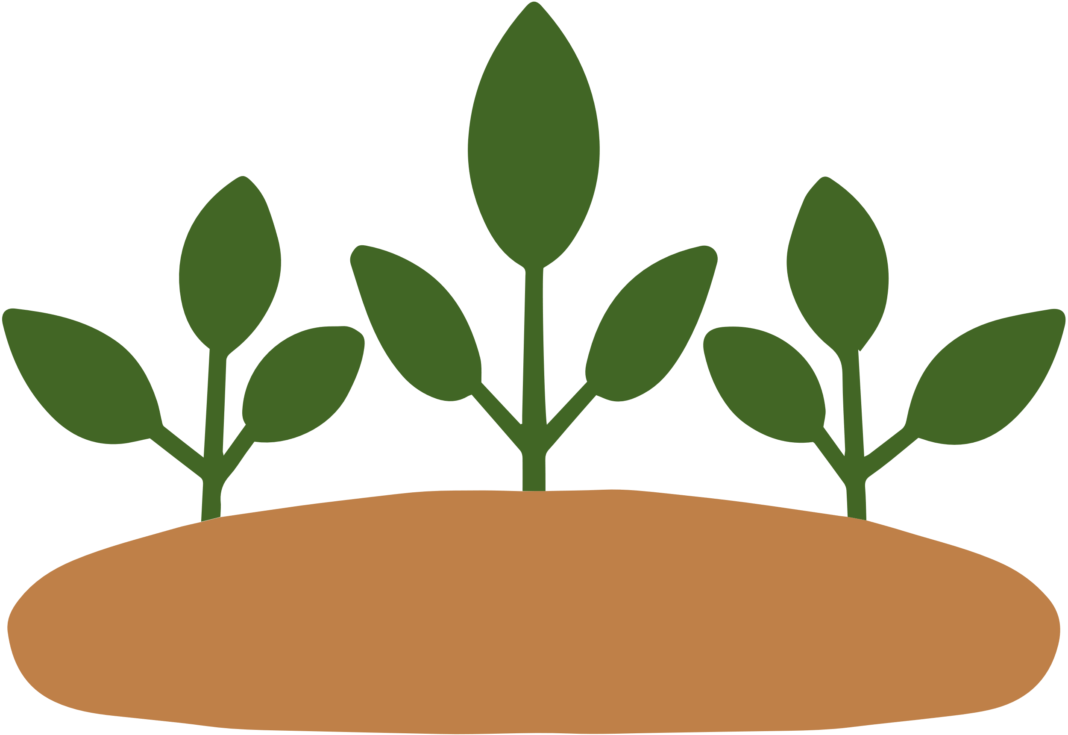
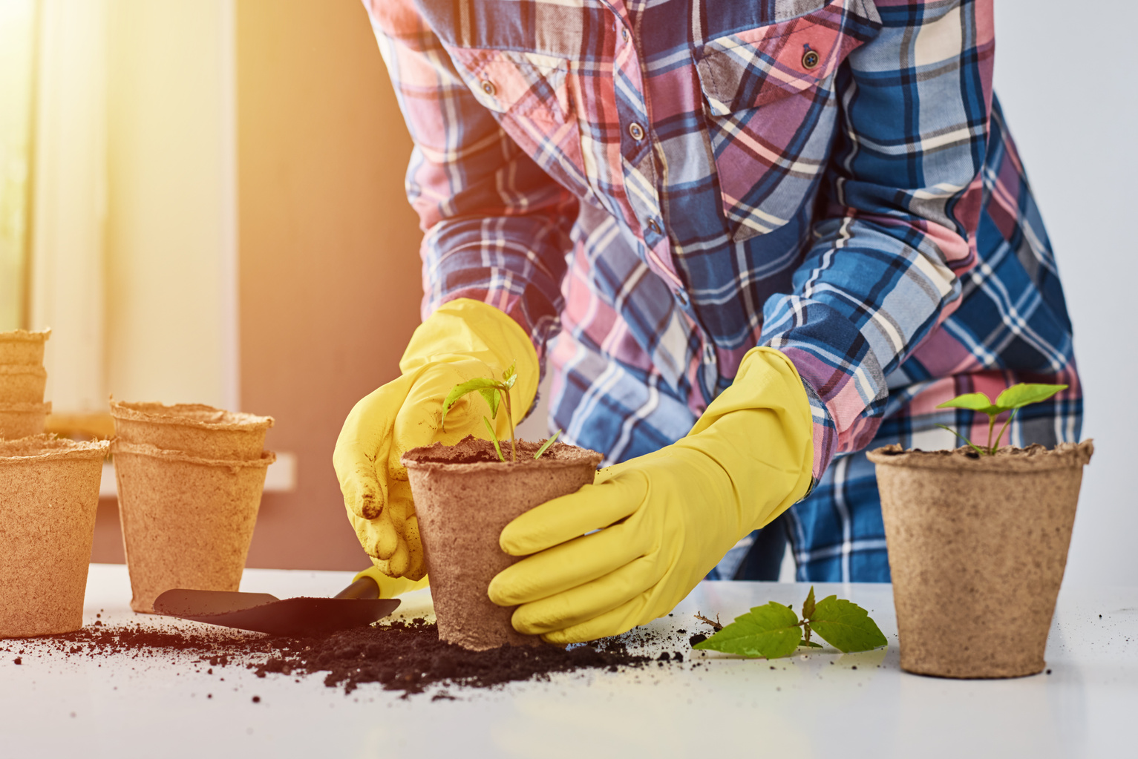
Users and Stakeholders
Users
Community Groups
Local Residents
Environmental Activists
Stakeholders
Food Banks
Volunteers
Garden Owners

Slide 4

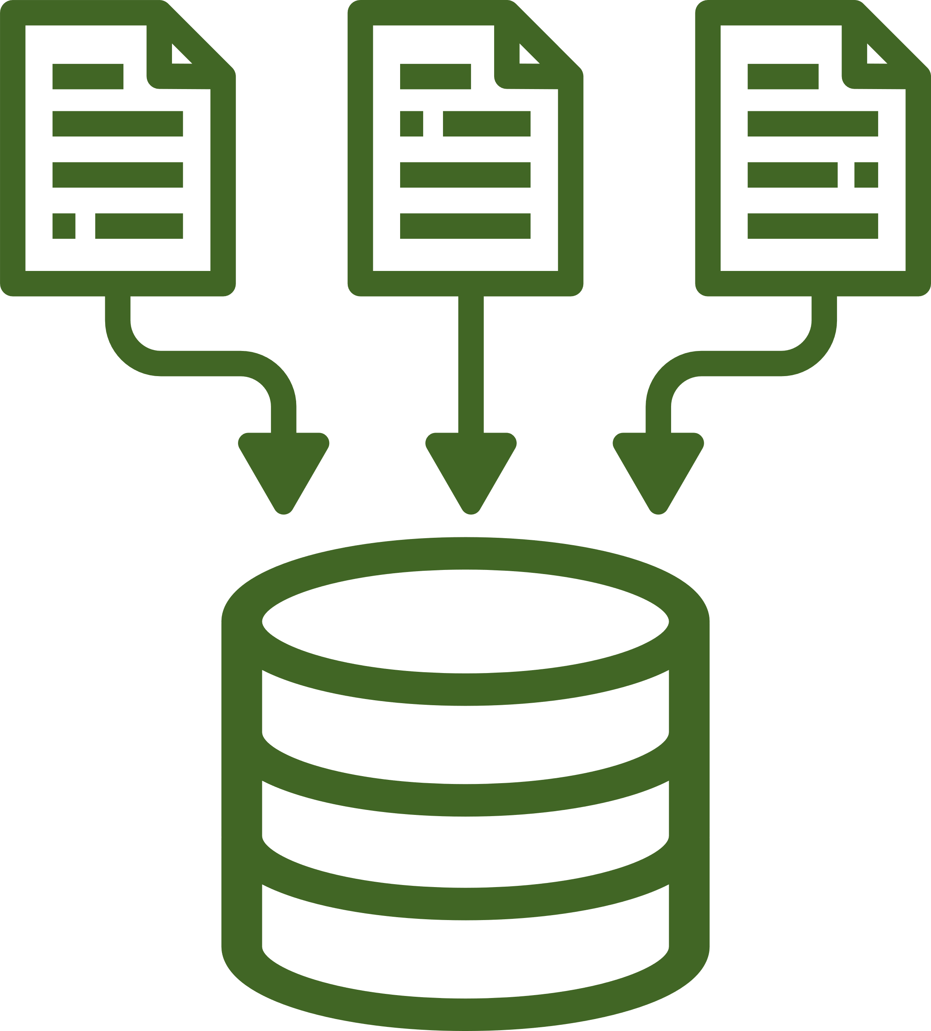
Our Approach
MERN Stack
Mongo DB
Express
React
Node
APIs
Trefle API
OpenStreetsMap API

Slide 5





Features (Functional)
Integrated Map
Resources
Plant Info Page
Volunteer Sign Up
User Authentication

Slide 6
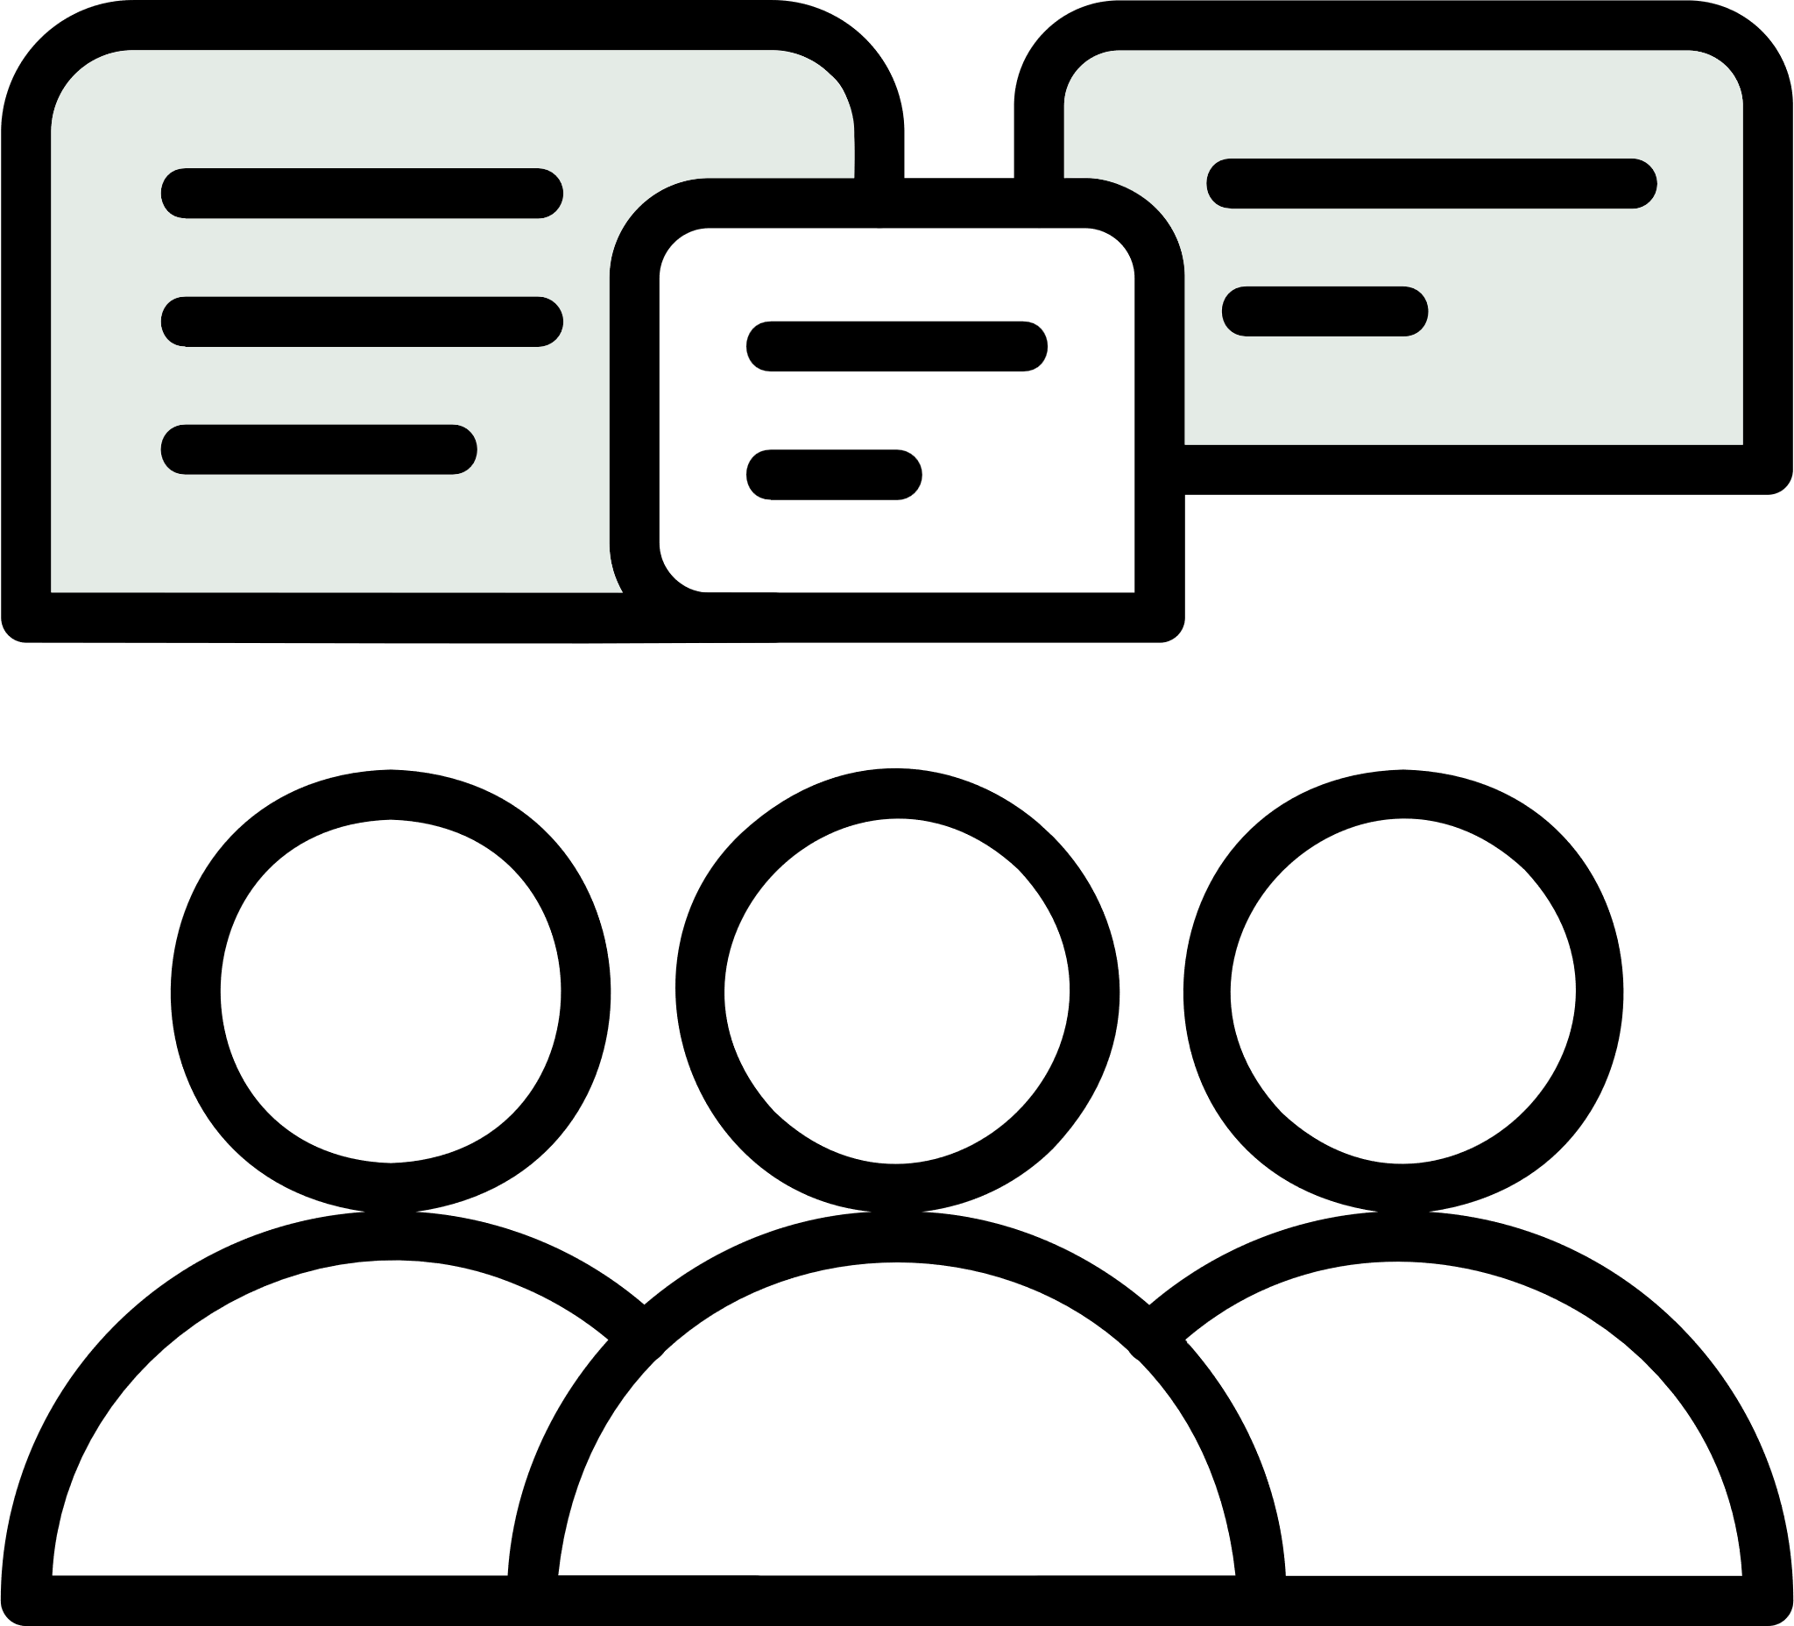



Features (Nonfunctional)
Discussion
Forum
User Post History
Real Time
Messaging
Google Calendar
Integration

Slide 7
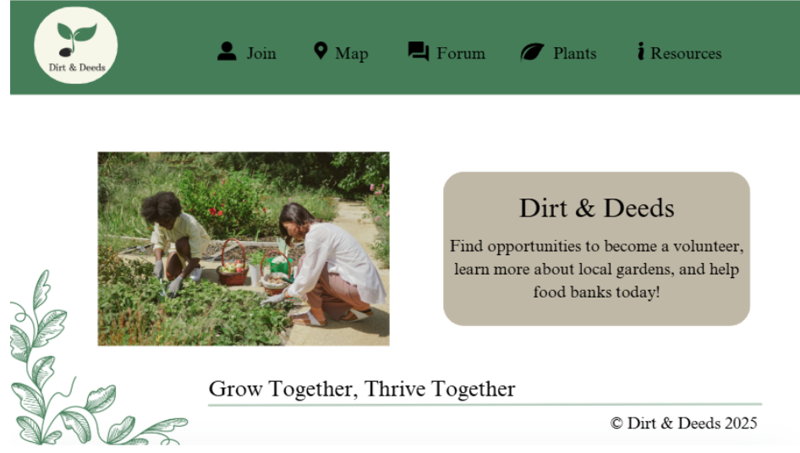
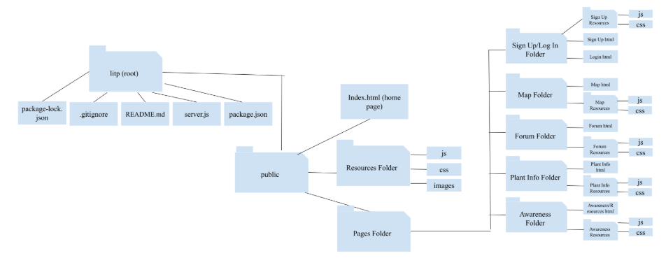
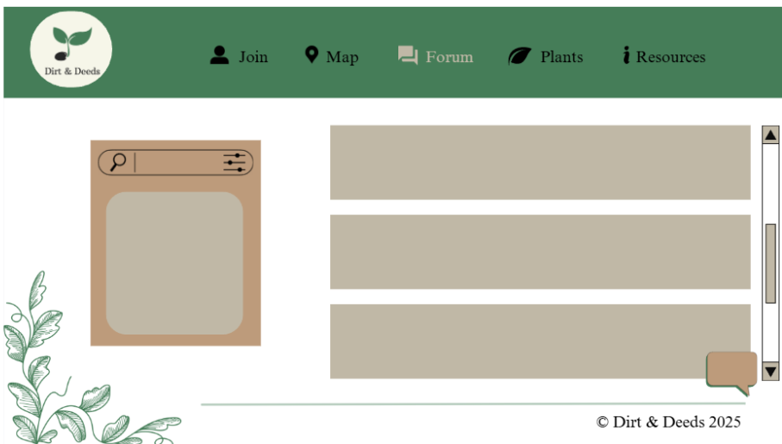
Wireframes
Sitemap

Slide 8
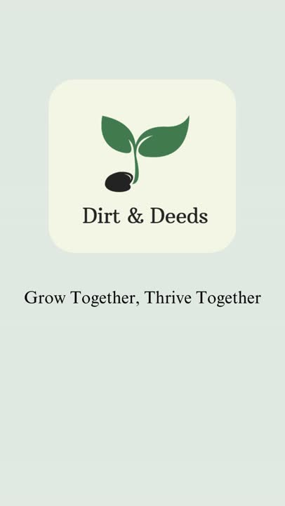
Our Video

